Slide 1

Data Communication and Computer Network BLM3051
Dr. Öğr. Üyesi Furkan ÇAKMAK

Slide 2

Lecture Information Form - Weekly Subjects
BLM3051
Data Communication and Computer Network - 4
Hafta | Tarih | Konular
1 | 20.02.2024 | Introduction to Data Communication Standards Used on Data Communication, Architectural models
2 | 27.02.2024 | OSI Reference Model , Layers and Their Functions, Signaling and Signal Encoding
3 | 05.03.2024 | Parallel and Serial Transmission, Communication Media and Their Technical Specs., Multiplexing (TDM, FDM)
4 | 12.03.2024 | Error Detection and Error Correction Techniques, Data Link Control Techniques, Flow Control
5 | 19.03.2024 | Asynchronous and Synchronous Data Link Protocols (BSC, HDLC)
6 | 26.03.2024 | LAN Technologies Continued, IEEE 802.4, 802.5, 802.11
7 | 02.04.2024 | Connectionless and Connection Oriented Services, Switching
8 | 09.04.2024 | Tatil – Ramazan Bayramı Arifesi
9 | 16.04.2024 | 1. Ara Sınav
10 | 23.04.2024 | Tatil – 23 Nisan Ulusal Egemenlik ve Çocuk Bayramı
11 | 30.04.2024 | Static and Dynamic Routing, Congestion in the Network Layer, Its Causes and Solutions
12 | 07.05.2024 | IP (Internetworking Protocol), ICMP, BOOTP, DHCP
13 | 14.05.2024 | 2. Ara Sınav
14 | 21.05.2024 | UDP (User Datagram Protocol), TCP (Transmisson Control Protocol)
Dr. Öğr. Üyesi Furkan ÇAKMAK

Slide 3
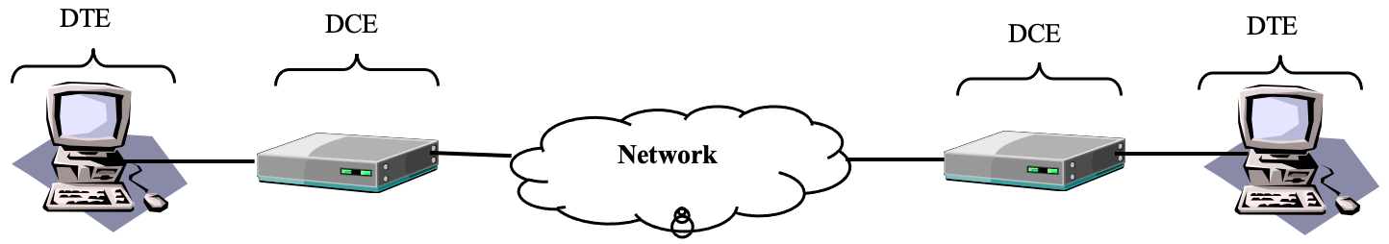
DTE-DCE Interfaces
BLM3051
Data Communication and Computer Network - 4
DCE (Data Circuit-Terminating Equipment)
Modem
DTE (Data Terminal Equipment)
Computer
Printer
Fax
etc.
Dr. Öğr. Üyesi Furkan ÇAKMAK

Slide 4
DTE-DCE Interfaces – Con’t
BLM3051
Data Communication and Computer Network - 4
Standards between DTE and DCE
EIA
EIA–232
EIA–442
EIA–449
ITU-T
V.24
V.32
V.32bis
V.34
X.2
X.24
Dr. Öğr. Üyesi Furkan ÇAKMAK

Slide 5
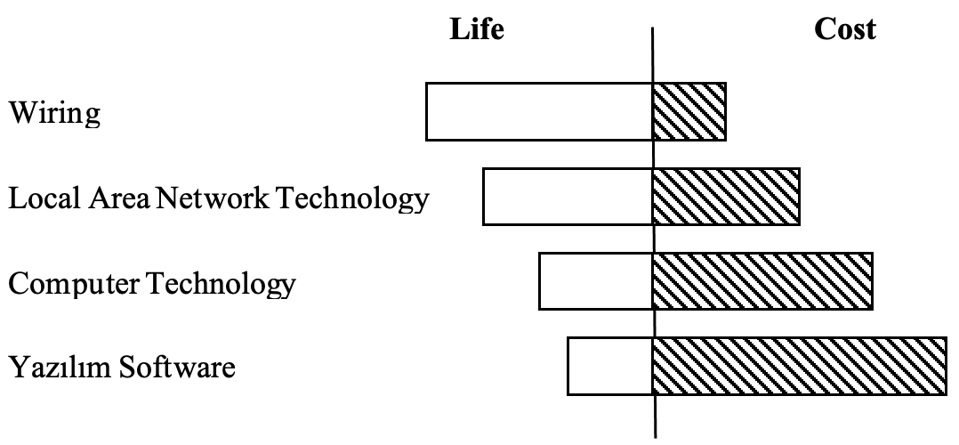
Transmission Medium
BLM3051
Data Communication and Computer Network - 4
Wire
Light
Radio Wave
Guided and Unguided media
Dr. Öğr. Üyesi Furkan ÇAKMAK

Slide 6
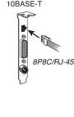
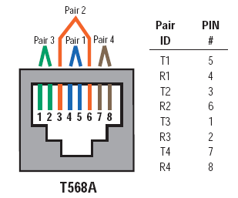
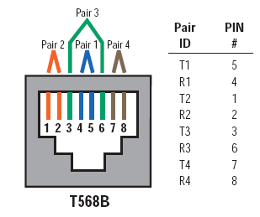

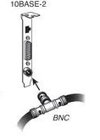
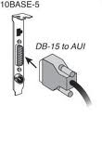
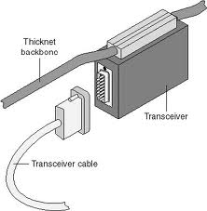



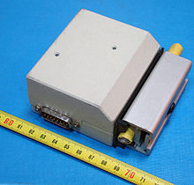

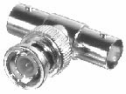

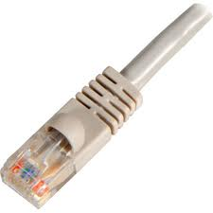
Guided Media
BLM3051
Data Communication and Computer Network - 4
Coaxial Cable
AUI (Attachement Unit Interface)
Ethernet
Thick: 10mm
Thin: 5mm
Twisted pair
DGM (Data Grade Medium)
CATs
2-12 twist/step
Different Colors
There are 3 different types:
UTP (Unshielded Twisted Pair)
100m = 90m + 10m
ScTP/FTP (Screened Twisted Pair/Foiled Twisted Pair)
STP (Shielded Twisted Pair)
Dr. Öğr. Üyesi Furkan ÇAKMAK

Slide 7
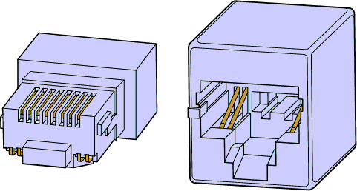
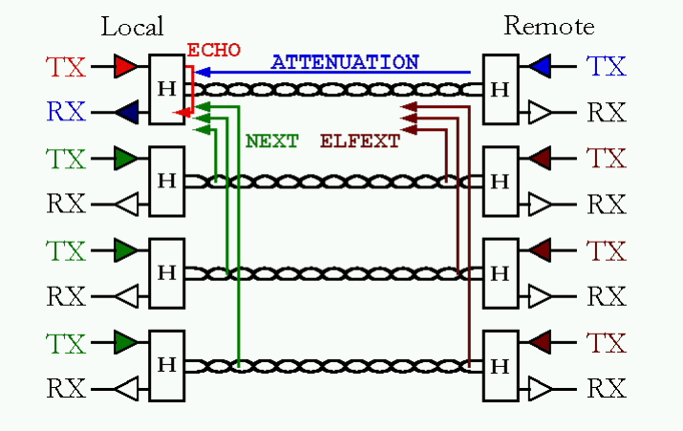
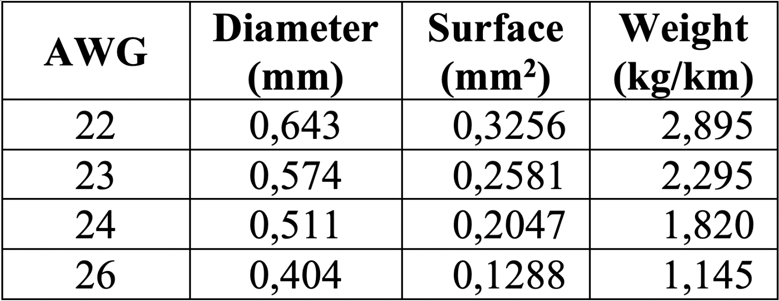
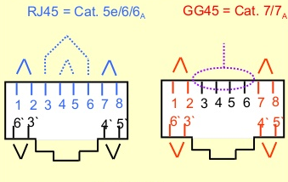
Guided Media – Con’t
BLM3051
Data Communication and Computer Network - 4
UTP cables category criterias:
Signal Frequency
Wire lenght
Correct connections
Attenuation
NEXT (Near-End Crosstalk)
PSNEXT (Power Sum NEXT)
FEXT (Far-End Crosstalk)
ELFEXT (Equal Level FEXT)
PSELFEXT (Power Sum ELFEXT)
CAT 5e
gigabit Ethernet
4 pieces of 2
Propagation delay
Skew
Fastest - Slowest
Dr. Öğr. Üyesi Furkan ÇAKMAK

Slide 8
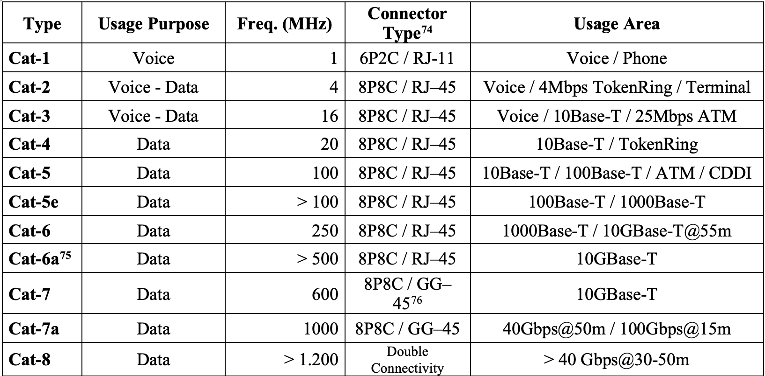
Classification of UTP Cables
BLM3051
Data Communication and Computer Network - 4
Dr. Öğr. Üyesi Furkan ÇAKMAK

Slide 9
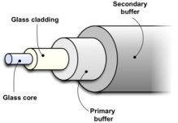
Guided Media – Fiber Optic Cabels
BLM3051
Data Communication and Computer Network - 4
Coaxial Cables
Twisted Pair Cables
Fiber Optic Cables
300.000 km/sec
>= 100 Gbps (reached 500 Gpbs)
Core
Cladding
Primary buffer
Secondary buffer
Armor
Plastic Shield
SMF (Single Mode Fiber)
MMF (Multi Mode Fiber)
Dr. Öğr. Üyesi Furkan ÇAKMAK

Slide 10
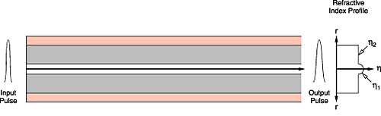

Guided Media – Fiber Optic Cabels – Con’t
BLM3051
Data Communication and Computer Network - 4
Single Mode Fiber (SMF)
Core: 9 μm
Light wavelength: 1.3 – 1.5 μm
1.3 μm $≈$ 9 μm $→$ Transmission is carried out as a single, unbreakable beam
Dr. Öğr. Üyesi Furkan ÇAKMAK

Slide 11
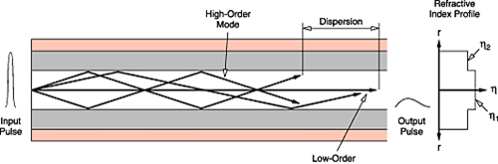
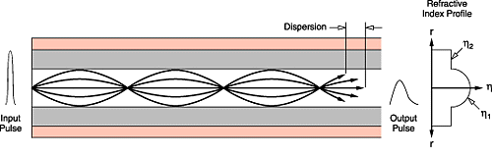
Guided Media – Fiber Optic Cabels – Con’t
BLM3051
Data Communication and Computer Network - 4
Step Index
Grade Index
Dr. Öğr. Üyesi Furkan ÇAKMAK

Slide 12
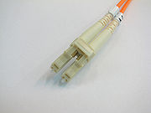
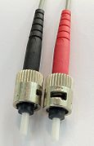
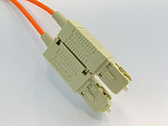
Guided Media – Fiber Optic Cabels – Con’t
BLM3051
Data Communication and Computer Network - 4
Dr. Öğr. Üyesi Furkan ÇAKMAK

Slide 13
Guided Media – Fiber Optic Cabels – Con’t
BLM3051
Data Communication and Computer Network - 4
Light sources used in fiber optic media:
LED (Light Emitting Diode)
Nonfocusable
ILD (Injection Laser Diode)
Focusable
Receiver side: fotodiod (Photosensitive cell)
It is a circuit element that can generate electrical signals depending on the strength of the light falling on it.
Dr. Öğr. Üyesi Furkan ÇAKMAK

Slide 14
Advantages of Fiber Optic Cables over Copper Cables
BLM3051
Data Communication and Computer Network - 4
Broad Bandwidth
Immunity to Electromagnetic Interference
Attenuation
Insulation
Space Saving
Security
Eavesdrop
Dr. Öğr. Üyesi Furkan ÇAKMAK

Slide 15
Things to Consider When using Fiber Optic Cables
BLM3051
Data Communication and Computer Network - 4
The core parts of the fibers used at both ends must overlap exactly.
Attention should be paid to dirt, oil, dust and scratches.
Dirt, dust, etc. should be cleaned with air gun or alcohol.
Scratches should be polished and rounded.
Fiber cables are fragile like glass and must be kept gently bent.
When not in use, fiber cables should be stored with special headers to protect them from dust and scratches.
The laser beam at the end of the fiber optic cable is dangerous to the eyes.
Dr. Öğr. Üyesi Furkan ÇAKMAK

Slide 16
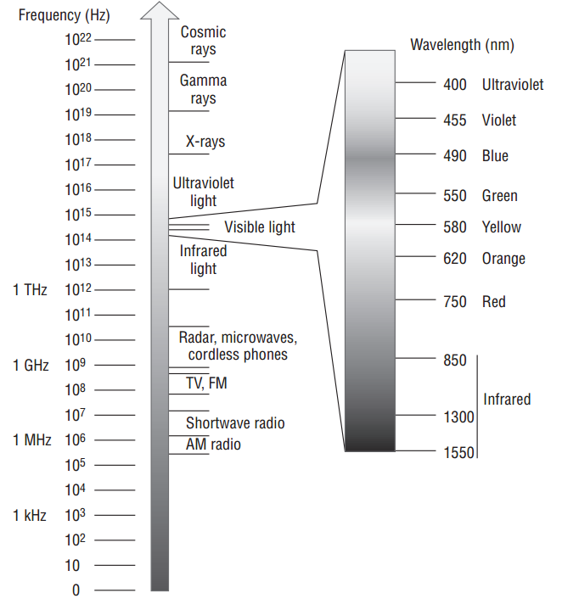
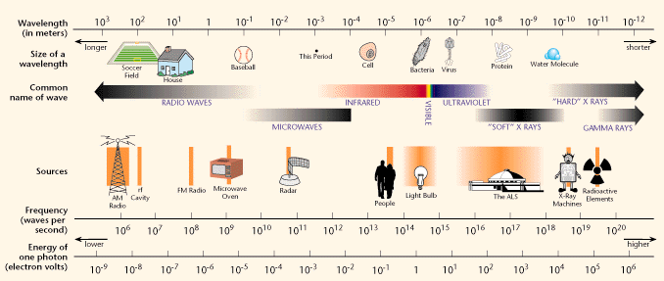
Unguided Media
BLM3051
Data Communication and Computer Network - 4
Technologies that aim to use the atmosphere:
RF (Radio Frequency)
Microwave
IR (Infra Red)
Ionosphere
Ground propagation < 2 MHz
Sky propagation 2-30 MHz
Line of sight propagation > 30 MHz
Dr. Öğr. Üyesi Furkan ÇAKMAK

Slide 17
Unguided Media - Radio Frequency
BLM3051
Data Communication and Computer Network - 4
3 kHz – 1 GHz
Television ve Radio
Omnidirectonal
Antennas do not need to be aligned
RF can go through the Wall.
Obtain approval from authorities to use RF.
Non-approval RF types:
Bluetooth, IEEE 802.11, etc.
Dr. Öğr. Üyesi Furkan ÇAKMAK

Slide 18
Unguided Media - Microwaves
BLM3051
Data Communication and Computer Network - 4
1-300 GHz
Satellite - Ground Station
Parabolic and horn antennas
Unidirectional
LOS – Line Of Sight
Microwaves can not go through the Wall
It can be harmful to the living creature between the transceiver, depending on the signal strength used.
Dr. Öğr. Üyesi Furkan ÇAKMAK

Slide 19
Unguided Media - Infra Red
BLM3051
Data Communication and Computer Network - 4
300GHz-400THz
Point-to-point
Device’s remotes
Infra Red can not go through the Wall
Tapping-eavesdropping
Jamming Immune
75 kbps in max. 8m distance
Top: 4 Mbps
Dr. Öğr. Üyesi Furkan ÇAKMAK

Slide 20
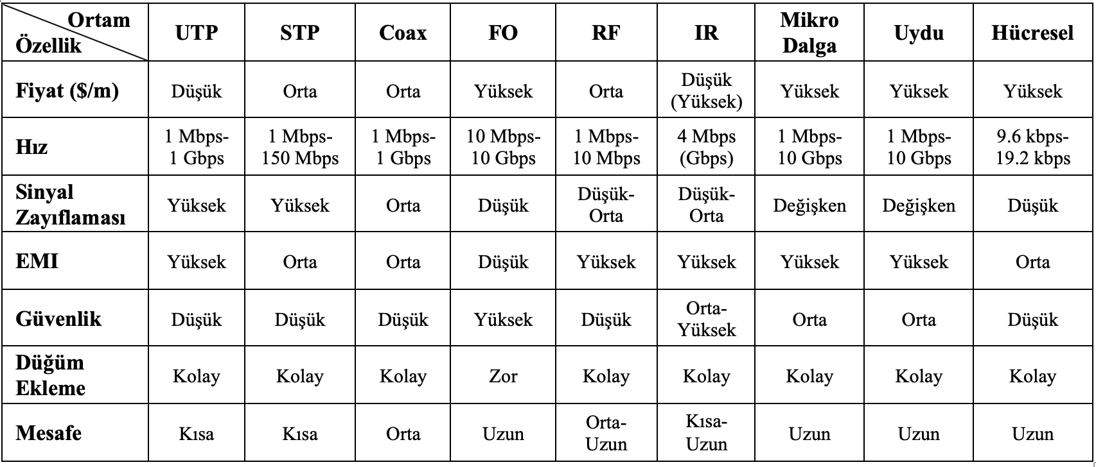
Comparison of Transmission Medium
BLM3051
Data Communication and Computer Network - 4
Dr. Öğr. Üyesi Furkan ÇAKMAK

Slide 21
Could There be an Alternative Option in Data Transmission?
BLM3051
Data Communication and Computer Network - 4
300GHz-400THz
Point-to-point
Device’s remotes
Infra Red can not go through the Wall
Tapping-eavesdropping
Jamming Immune
75 kbps in max. 8m distance
Top: 4 Mbps
Dr. Öğr. Üyesi Furkan ÇAKMAK

Slide 22
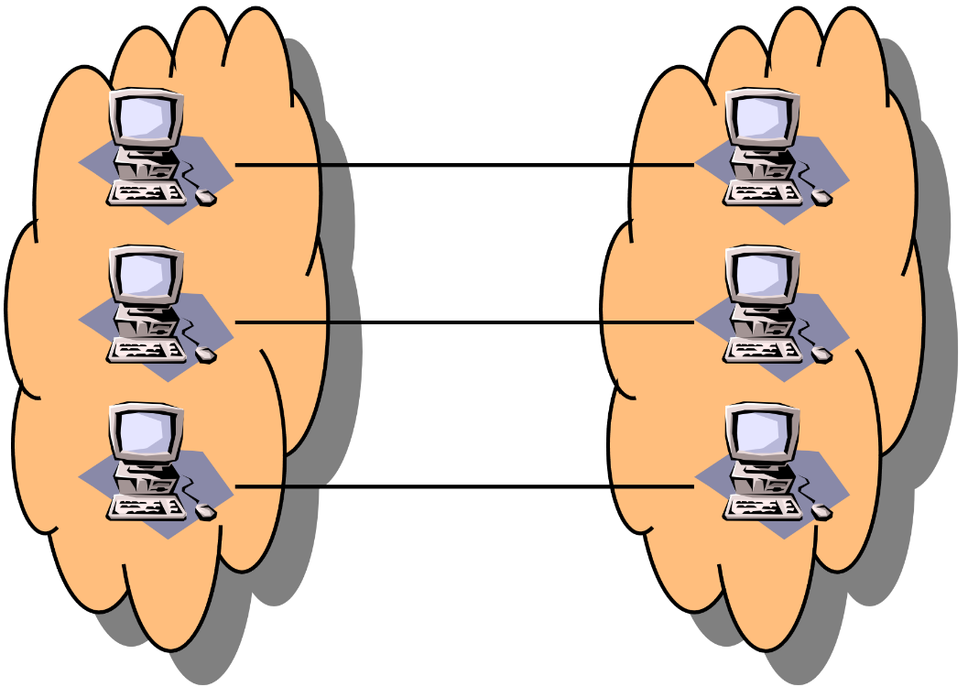
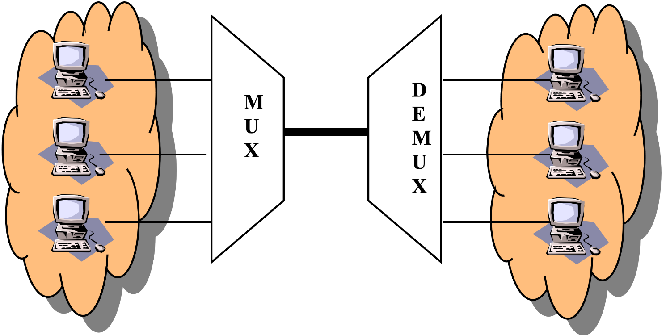
Multiplexing
BLM3051
Data Communication and Computer Network - 4
Dr. Öğr. Üyesi Furkan ÇAKMAK

Slide 23
Multiplexing Technics
BLM3051
Data Communication and Computer Network - 4
FDM (Frequency Division Multiplexing)
WDM (Wavelength Division Multiplexing)
TDM (Time Division Multiplexing)
Dr. Öğr. Üyesi Furkan ÇAKMAK

Slide 24
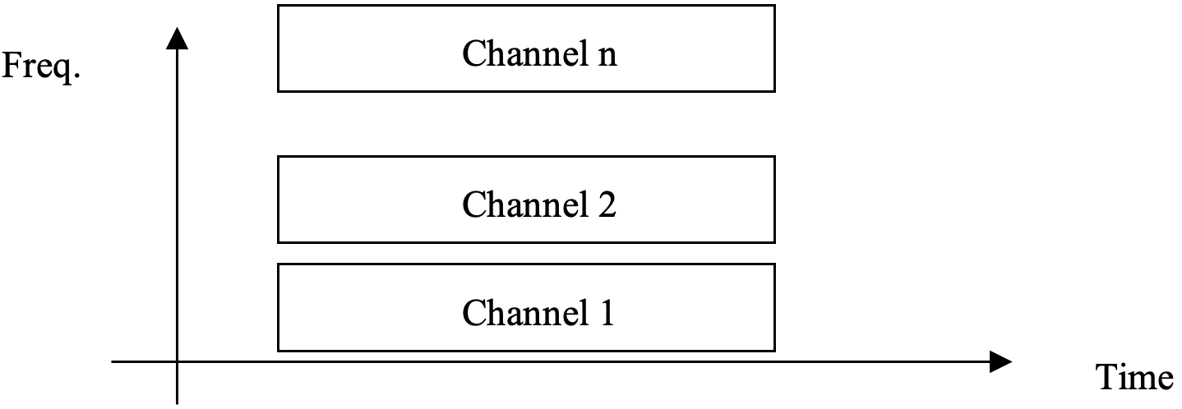

FDM (Frequency Division Multiplexing)
BLM3051
Data Communication and Computer Network - 4
$\sum{(p2p BW)<total BW}$
Each signal has a different carriage signal
The signal to be sent is the sum of the carrier signals
Voice: 300-3300Hz BW
Guarded Band
Television and radio broadcasts
Dr. Öğr. Üyesi Furkan ÇAKMAK

Slide 25
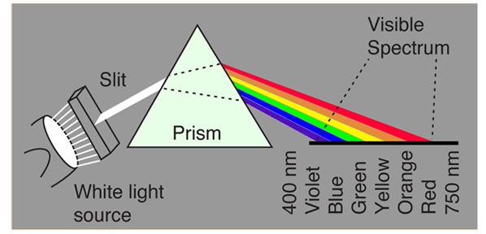
WDM (Wavelength Division Multiplexing)
BLM3051
Data Communication and Computer Network - 4
Like FDM in FO
Dr. Öğr. Üyesi Furkan ÇAKMAK

Slide 26
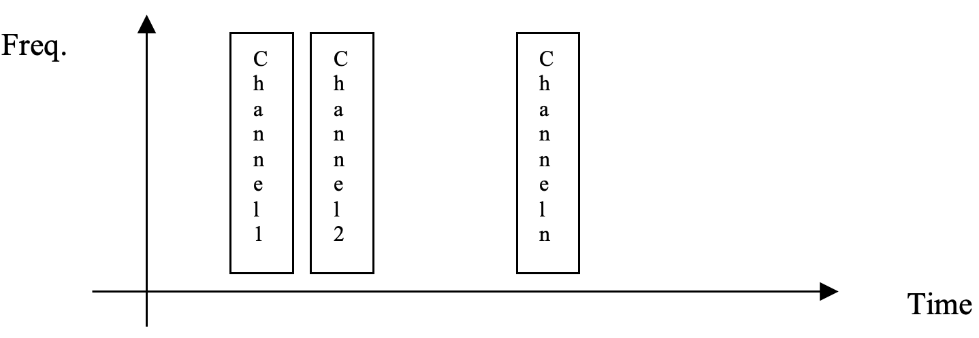

TDM (Time Division Multiplexing)
BLM3051
Data Communication and Computer Network - 4
$\max\left(p2p BW\right)<BW$
2 Types
Synchronous TDM
Data
Digitized Voice
Asynchronous TDM
Dr. Öğr. Üyesi Furkan ÇAKMAK

Slide 27
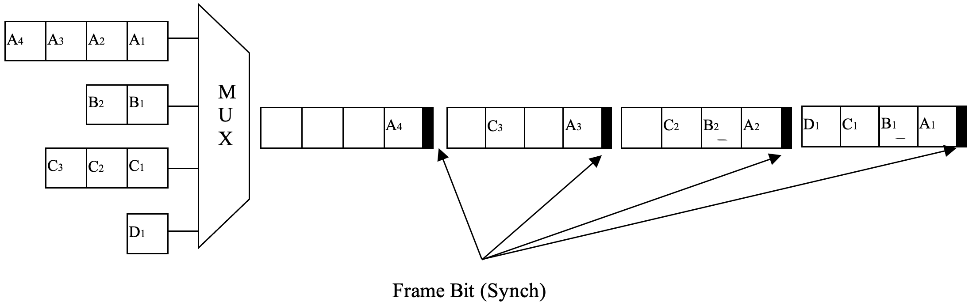
Synchronous TDM
BLM3051
Data Communication and Computer Network - 4
Dr. Öğr. Üyesi Furkan ÇAKMAK

Slide 28
Synchronous TDM – Con’t
BLM3051
Data Communication and Computer Network - 4
Example
In Sync. TDM where 4 units are connected, each unit produces 250 characters / sec output.
1 bit is used for each frame to ensure synchronization.
Each frame contains a character from each unit.
Accordingly, calculate the obtained data communication speed as bps.
Answer:
250 frame + 250 bit (for sync.)
250 frame x (4 unit x 8 bits/unit) / frame + 250 bit = 8250 bps
Dr. Öğr. Üyesi Furkan ÇAKMAK

Slide 29
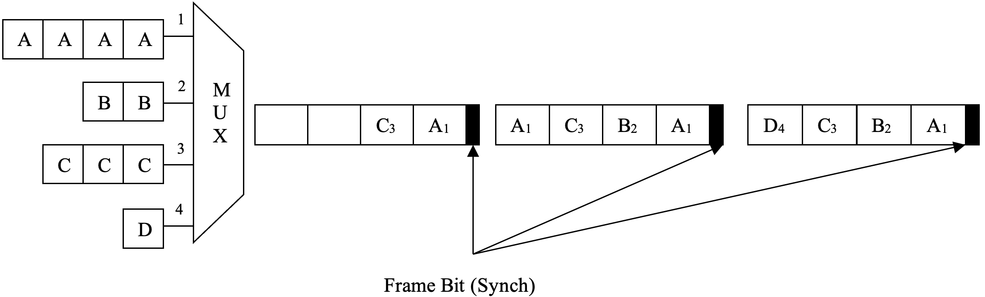
Asynchronous TDM
BLM3051
Data Communication and Computer Network - 4
Dr. Öğr. Üyesi Furkan ÇAKMAK

Slide 30
Error Detection and Correction Techniques
BLM3051
Data Communication and Computer Network - 4
Data Link Layer (in OSI model)
Error reasons
Attenuation
Delay Distortion
Video + Voice
Problem in time sensitive conditions
Noise in the communication environment
Thermal noise
Random electron motion
Intermodulation noise
CrossTalk
Impulse Noise
Dr. Öğr. Üyesi Furkan ÇAKMAK

Slide 31
Error Types
BLM3051
Data Communication and Computer Network - 4
Data Sent
Data Received
Single bit error
Multi bit error
Error bursts
1 | Ø | Ø | Ø | Ø | 1 | 1 | 1
1 | Ø | 1 | Ø | Ø | 1 | 1 | 1
1 | Ø | Ø | Ø | Ø | 1 | 1 | 1
1 | Ø | 1 | Ø | Ø | Ø | 1 | 1
1 | Ø | Ø | Ø | Ø | 1 | 1 | 1
1 | Ø | Ø | 1 | 1 | Ø | Ø | 1
Dr. Öğr. Üyesi Furkan ÇAKMAK

Slide 32
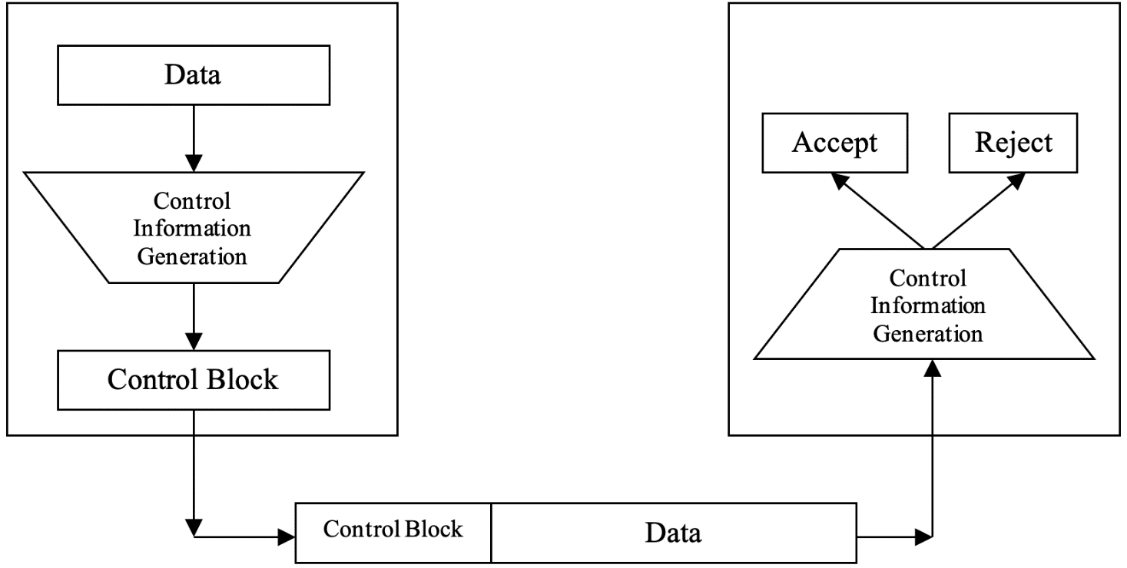
Error Detection
BLM3051
Data Communication and Computer Network - 4
Both sides have original data?
Sending data twice?
Control block?
4 different types
VRC (Vertical Redundency Code)
LRC (Longitudial Redundency Code)
CRC (Cyclic Redundency Check)
Checksum
Dr. Öğr. Üyesi Furkan ÇAKMAK

Slide 33
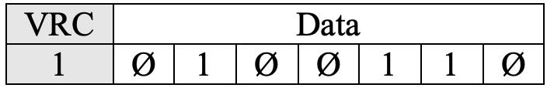
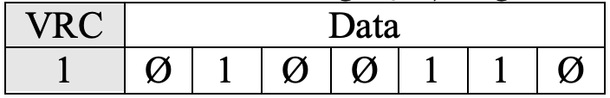
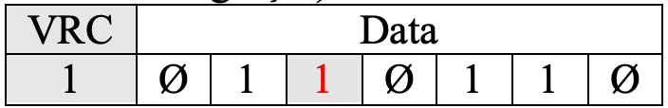
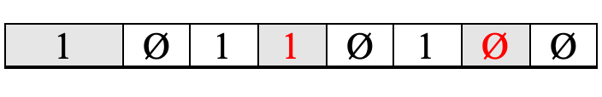
VRC (Vertical Redundency Code)
BLM3051
Data Communication and Computer Network - 4
Parity check
Simple error coding technique
The number of errors should be odd.
XOR operation
Data Sent
Data Received 1
Data Received 2
Data Received 3
Dr. Öğr. Üyesi Furkan ÇAKMAK

Slide 34
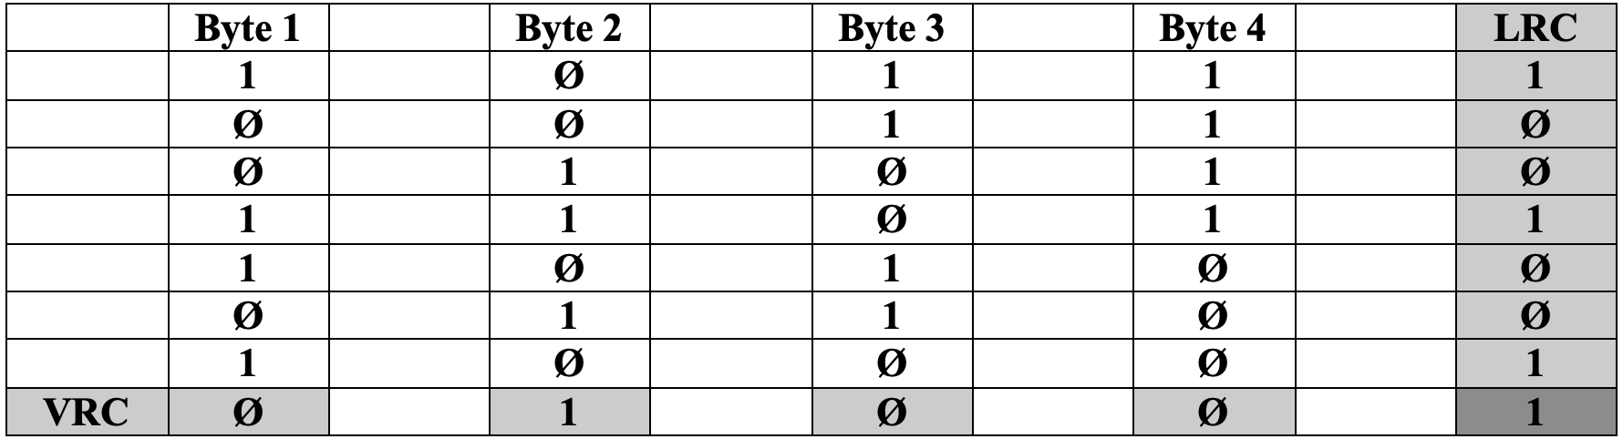
LRC (Longitudial Redundency Code)
BLM3051
Data Communication and Computer Network - 4
LRC is 2D-VRC
Dr. Öğr. Üyesi Furkan ÇAKMAK

Slide 35
CRC (Cyclic Redundency Check)
BLM3051
Data Communication and Computer Network - 4
The data to be sent is divided into a predetermined prime polynomial.
The remainder value is added to the data to be sent as an error control code.
The remainder zero in receiver side means that error-free transmission.
Common polynomials used for CRC: 13-bits, 17-bits, 33-bits
The number of undetectable errors is almost zero
Commonly used polynomials in CRC technique:
CRC-12 x¹²+x¹¹+x³+x+1
CRC-16 x¹⁶+x¹⁵+x²+1
CRC-ITU x¹⁶+x¹²+x⁵+1
CRC-32 x³²+x²⁶+x²³+x²²+x¹⁶+x¹²+x¹¹+x¹⁰+x⁸+x⁷+x⁵+x⁴+x²+x+1
Dr. Öğr. Üyesi Furkan ÇAKMAK

Slide 36

CRC (Cyclic Redundency Check) - Con’t
BLM3051
Data Communication and Computer Network - 4
Example: Data Sent: 100100, polynom: x³ + x² + 1, CRC = ?
Dr. Öğr. Üyesi Furkan ÇAKMAK

Slide 37
Checksum
BLM3051
Data Communication and Computer Network - 4
The sender divides the data into N-bits parts (usually 16 bits are used).
The parts are collected using the first complementary arithmetic.
In this way, a total value of only N bits is obtained.
Calculate two's complement using summed value
The calculated value is added to the end of the information to be sent.
The checksum detects all of the odd errors and most of the even numbers.
However, if one or more bits in a part are 0 when they are 1, but there is a 0 when 1 in another part, the error will not be understood because there will be no difference in this column sum.
Dr. Öğr. Üyesi Furkan ÇAKMAK

Slide 38
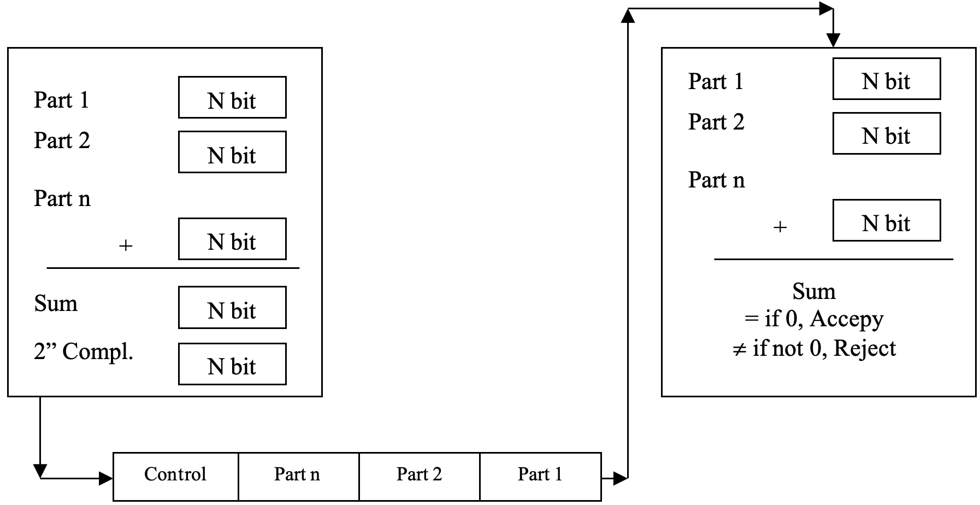
Checksum - Con’t
BLM3051
Data Communication and Computer Network - 4
Dr. Öğr. Üyesi Furkan ÇAKMAK

Slide 39
Error Correction
BLM3051
Data Communication and Computer Network - 4
2 methods
Send data again
If one bit error
Hamming Code / Distance
Dr. Öğr. Üyesi Furkan ÇAKMAK

Slide 40

Hamming Code
BLM3051
Data Communication and Computer Network - 4
If we sent m bit data, the error occurs in 1,2,…,m bit
Adding error-free state, the data length will be m+1
Control block length must be $\log_{2}\left(m+1\right)≤r$
$m+r$bit must be sent error-free
So, control block length must be $\log_{2}\left(m+r+1\right)≤r$
(1, 2, 4, 8, 16. bits)
Dr. Öğr. Üyesi Furkan ÇAKMAK

Slide 41
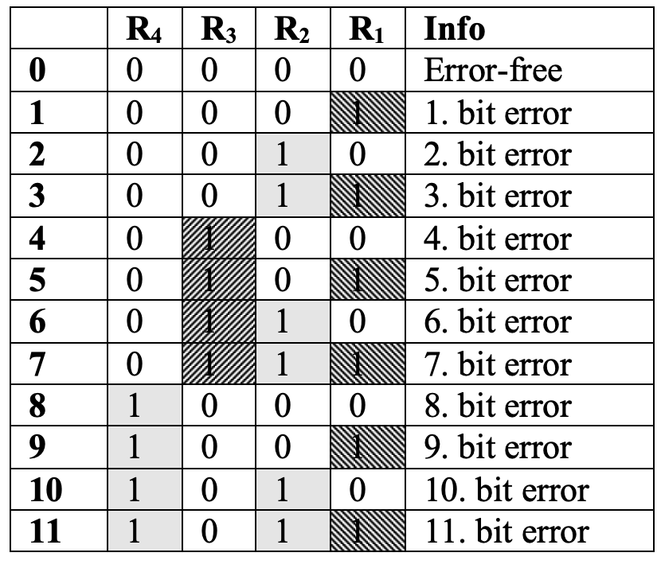
Hamming Code – Con’t
BLM3051
Data Communication and Computer Network - 4
R₁=B₁⊕B₃⊕B₅⊕B₇⊕B₉⊕B₁₁
R₂=B₂⊕B₃⊕B₆⊕B₇⊕B₁₀⊕B₁₁
R₃=B₄⊕B₅⊕B₆⊕B₇
R₄=B₈⊕B₉⊕B₁₀⊕B₁₁
R₁=B₃⊕B₅⊕B₇⊕B₉⊕B₁₁ ₌ 1⊕0⊕1⊕0⊕1 = 1
R₂=B₃⊕B₆⊕B₇⊕B₁₀⊕B₁₁ ₌ 1⊕1⊕1⊕0⊕1 = 0
R₃=B₅⊕B₆⊕B₇ ₌ 0⊕1⊕1 = 0
R₄=B₉⊕B₁₀⊕B₁₁ ₌ 0⊕0⊕1 = 1
Dr. Öğr. Üyesi Furkan ÇAKMAK

Slide 42
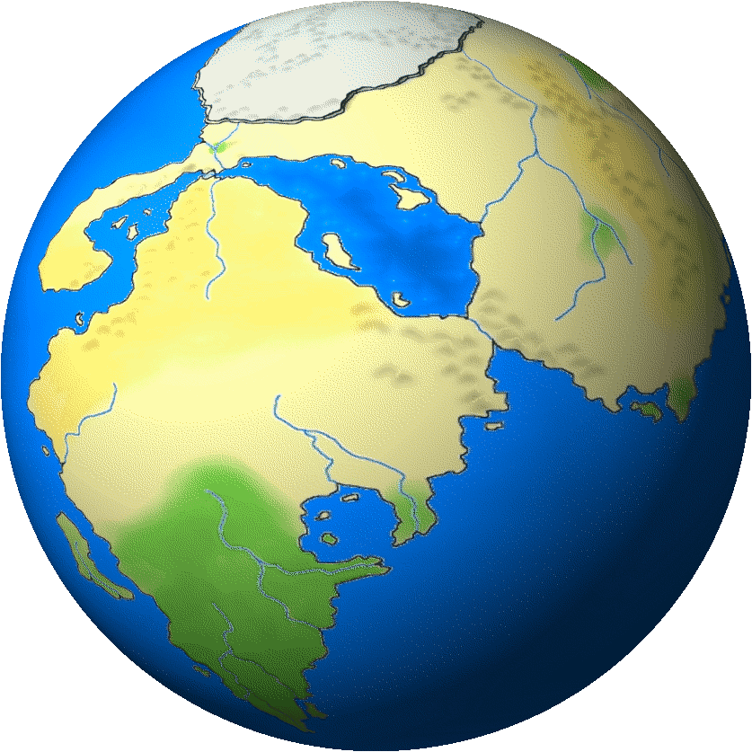
Thank you for your listening.
BLM3051
Data Communication and Computer Network - 4
Dr. Öğr. Üyesi Furkan ÇAKMAK

